Slide 1

MAVERICK BANK
Case Study
Presented By
Doddoji Likhitha

Slide 2

Agenda
Mission & Vision
Project Structure
Implementation Plan
SQL Server Database Design
Coding Part Implemented Features
Testing Part
Reports
SonarQube Report

Slide 3
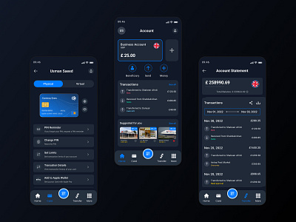
Mission & Vision
Maverick Bank is a robust, secure, and scalable banking platform designed to provide seamless financial services to Customers, Employees, and Administrators.
Built with high-performance technologies, it handles everything from account management and loan disbursement to real-time financial reporting.

Slide 4
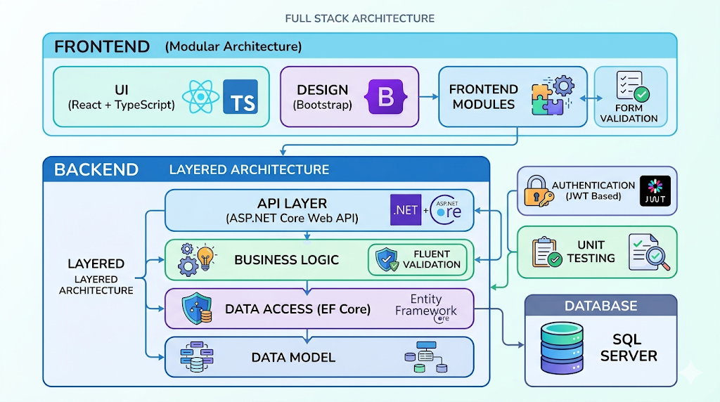
Project Structure
Frontend: React + TypeScript + Bootstrap
Backend: ASP.NET Core Web API
Database: SQL Server
Backend Architecture: Layered Architecture
Frontend Architecture: Modular Architecture
Authentication: JWT Based
ORM: Entity Framework Core
Validation: Fluent Validation, Form Validation
Testing: Unit Testing

Slide 5
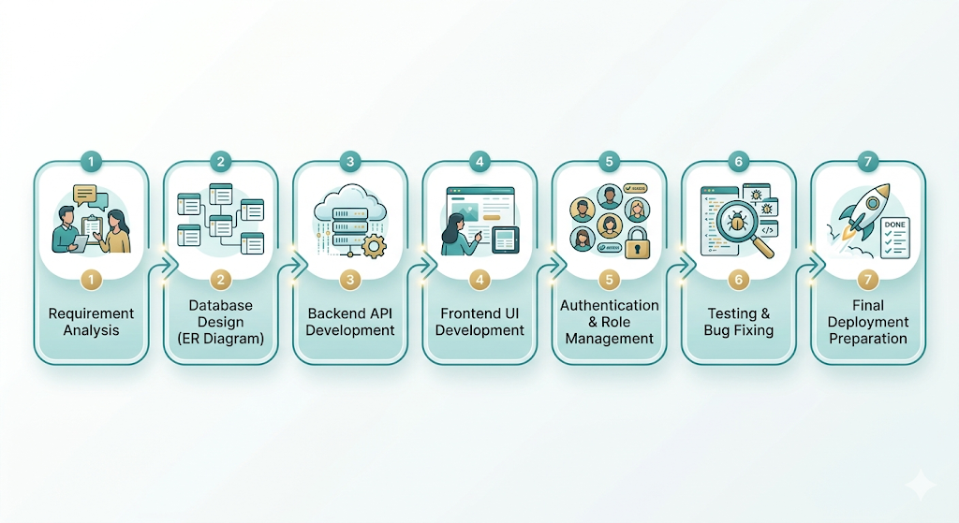
Implementation Plan
Requirement Analysis
Database Design (ER Diagram)
Backend API Development
Frontend UI Development
Authentication & Role Management
Testing & Bug Fixing
Final Deployment Preparation

Slide 6
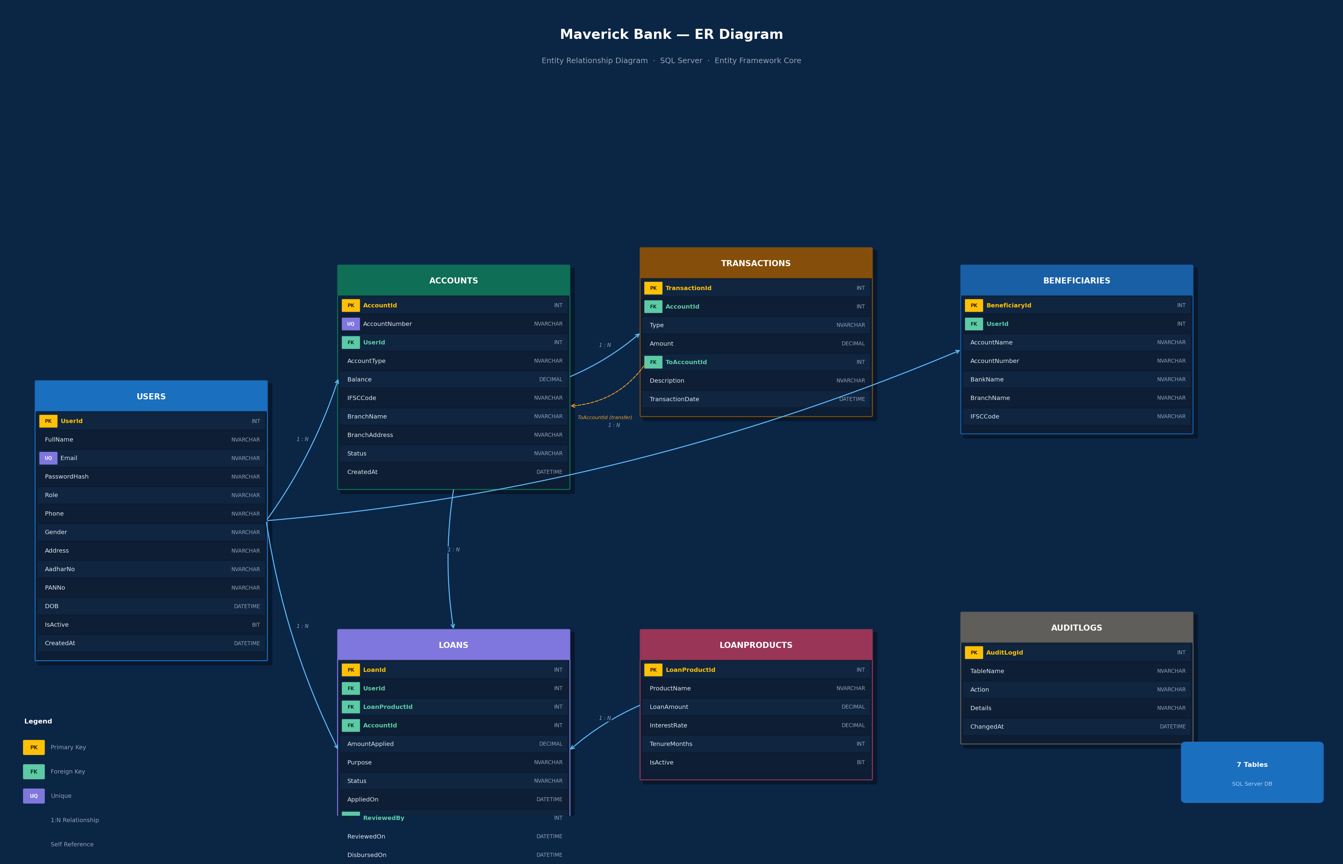
SQL Server Database Design
Database Tables
Users
Accounts
Transactions
Beneficiaries
Loans
Loan Products
Audit Logs

Slide 7
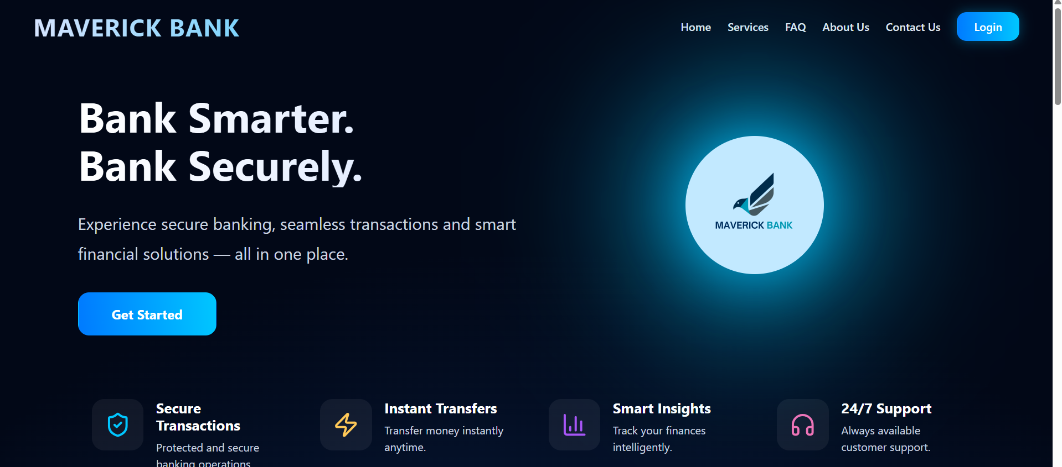
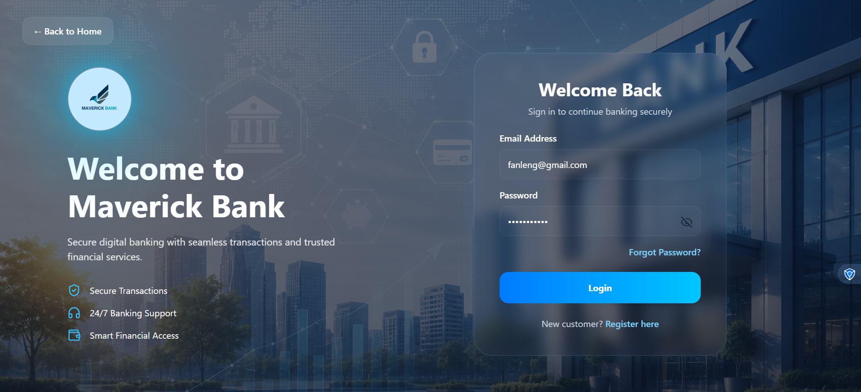
Coding Part Implemented Features
User Registration & Login
Customer Dashboard
Account Management
Deposit, Withdraw, Transfer
Beneficiaries
Loan Application & Approval
Employee Management
Admin Dashboard
Reports & Analytics

Slide 8

Testing Part
Unit Testing
Login Validation
Deposit & Withdrawal Validation
Loan Approval Validation
Account Closure Validation
Role-Based Access Testing
Error Handling & Form Validation

Slide 9
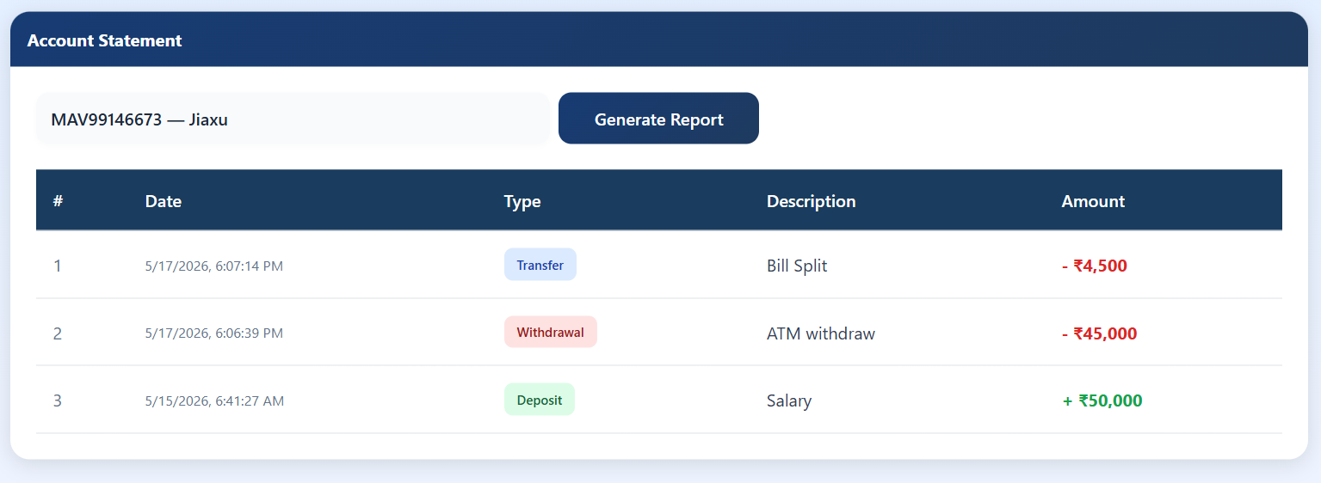
Reports
Account Statement Generation
Transaction History Reports
User Statistics Dashboard
Loan Status Monitoring
Banking Overview Analytics

Slide 10
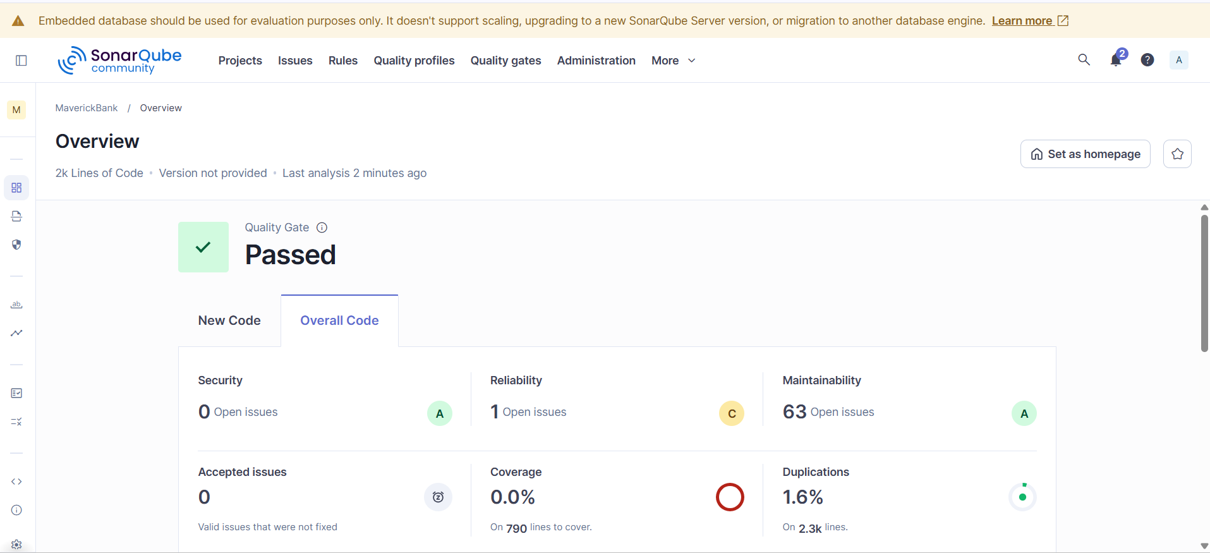
SonarQube Report

Slide 11
THANK YOU

